Slide 1
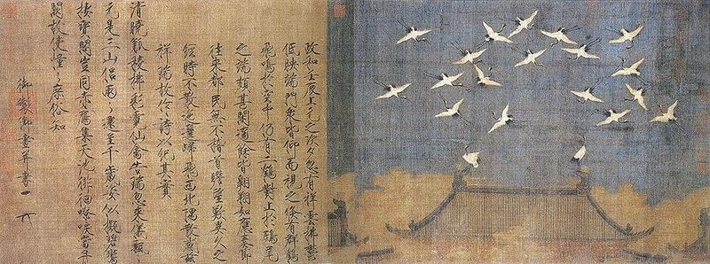
Five Dynasties - Song Dynasty
Auspicious Cranes (瑞鶴). This is a hand scroll of ink and color on silk executed by Emperor Huizong of Song or one of his court artists in the year 1112 AD. On the hand scroll , it is written that a flock of cranes hovered around and perched on one of the palace buildings. To commemorate this auspicious omen, Huizong composed a poem for the event. The hand scroll is located at the Liaoning Provincial Museum, Shenyang. This image appears on page 151 of Patricia Ebrey's Cambridge Illustrated History of China. (Wiki Commons)

Slide 2
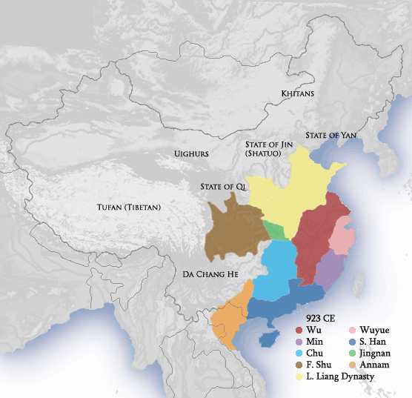
Five Dynasties Period (908-969)
Chaos again, but reunification quickly achieved
Political pragmatism rewarded. “Pure” Confucianism weak!

Slide 3
Printing
Feng Dao 馮道 (882-946) in 932 ordered the printing of the Confucian classics from wood blocks. The work of editing and printing takes 21 years and extends to 130 volumes.
Woodblock printing had been available in private hands since the late Tang dynasty.
Movable print printing was invented by commoner Bi Sheng 畢昇 (990-1051) in ca. 1041.
The first Gutenberg Bible was printed 400 years later in 1454.

Slide 4
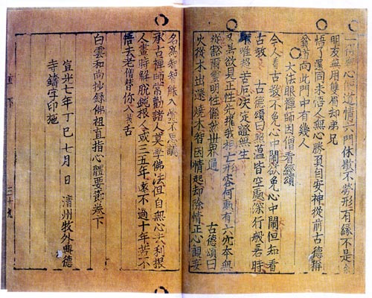
Selected Teachings of Buddhist Sages and Son Masters, 1377. Earliest known book printed with moveable metal type.

Slide 5
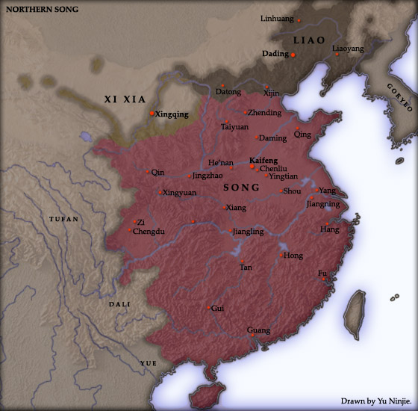
Northern Song (960-1126)
Chinese court under constant threat from northern nomads - Liao & Xi Xia, and later the Jin.

Slide 6
Song Dynasty as “Early Modern” (Important cultural and institutional innovations that remained unchanged until modern times)
Great increase in domestic and international trade.
Decline of aristocracy; supremacy of bureaucratic scholar class.
Victory of civilian leadership.
Focus of China shifts southward.
Cultural center moved to urban areas; rise of “absentee landlords.”

Slide 7
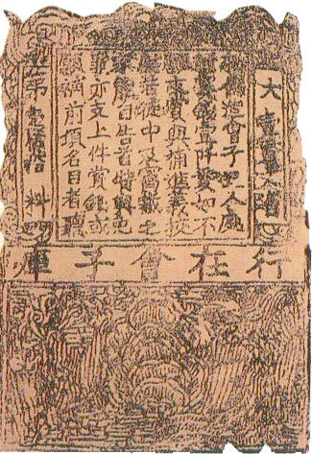
Technological Innovation
In 1023 the Song government issued bank notes of various denominations, and China produced the world's first governmental currency reserve bank.
The first Western paper money was issued in Sweden in 1661.

Slide 8
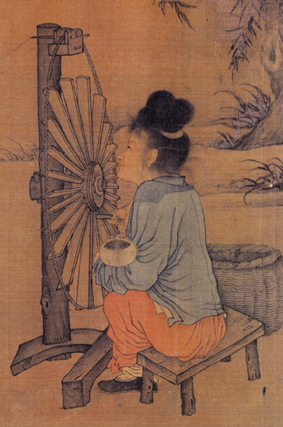
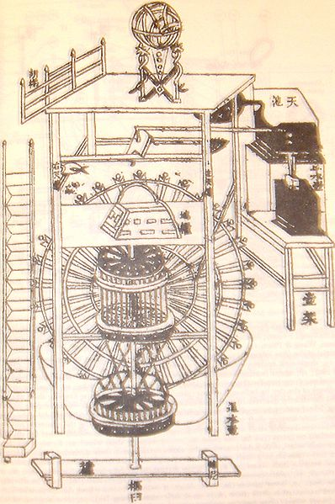
Technological Innovation
The spinning wheel was likely invented in China in during the 11th century, and introduced to Europeans during the Yuan dynasty.
Rockets were invented at the end of the 12th century, and they were used in warfare, along with bombs, despite the popular notion in the West.
Iron and steel technology and production blossomed; in 1078, Northern China was producing 2.5 to 5 times the amount of iron produced in England in the 1640's (Dull).

Slide 9
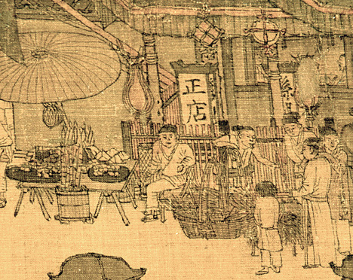
The Song Dynasty benefited from twin revolutions of agriculture and commerce.
Champa rice was introduced in drought-stricken Fujian in 1027, and became double-cropping mainstay.
Cash crops such as sugarcane in Sichuan emerge; city-dwellers showed a great liking for sweets.

Slide 10
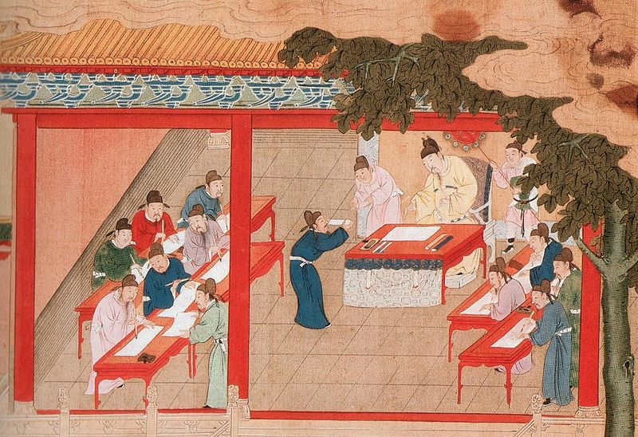
Rise of the Civil Service Exams

Slide 11
Rise of the Literati Class
The gentry class: dominated government service and managed society; during the Song predominantly large landowners, in later dynasties, entrepreneurial families also entered this class, but only through successful degree-holders. Passing the exams (or gaining office) was the sole criteria for membership in this class.
Due to the expansion of the exam system, "a non-hereditary, literate managerial class became the new mainstay of the social order- basically a class of landowners, but one that eventually derived as much income from commercial investments and salaried services as from land rents (Hucker, p. 329)."
There was also an expansion of clan organizations. Song official doctrine stated that the more generations that lived under one roof, the more stable society would become.

Slide 12
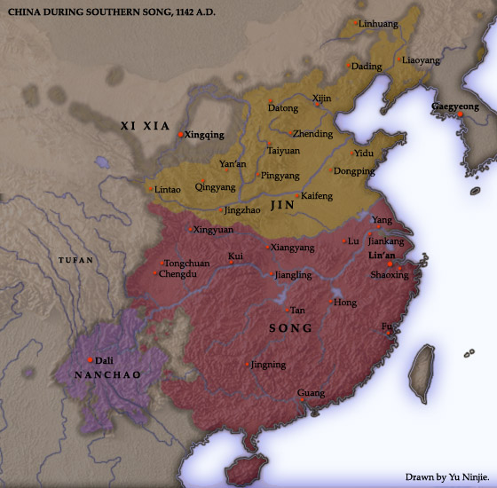
Southern Song (1127-1279)
Fall of the Northern Song is a major crisis.
Court vision increasingly turns inward.

Slide 13
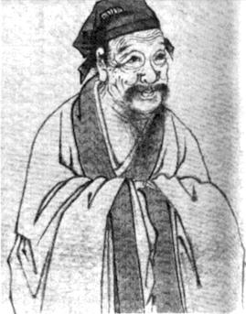
Zhu Xi 朱熹(1130-1200)
Not a leading official, but a prolific writer.
Known as the "Great Synthesizer” for borrowing from Daoism and Buddhism to revitalize Neo-Confucianism.
Central ideas include principle (li,理), manifestation (qi, 氣), , and the Supreme Ultimate (taiji, 太极)
Zhu Xi strongly emphasized the application of his principles to public service.

